Slide 1
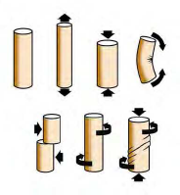
Concepts of Stresses and Strain
Prof. Sanjay Gupta
Department of Mechanical Engineering
IIT Kharagpur

Slide 2
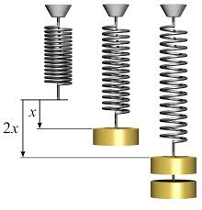
Deformation of a Solid
Solids deform when they are subject to forces.
Compressed, stretched, bent, twisted
They can maintain or lose their shape
The ratio of the force to the displacement is a constant.
Hooke’s Law

Slide 3
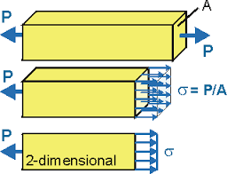
Stress
A force on a solid acts on an area.
For compression or tension, the normal stress σ is the ratio of the force to the cross sectional area.
Measures pressure
SI unit pascal
Pa = N / m² = kg / m s²

Slide 4
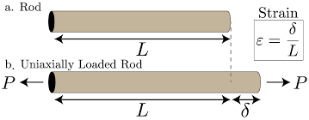
Strain
Deformation is relative to the size of an object.
The displacement compared to the length is the strain ε.
Measures a fractional change
Unitless quantity

Slide 5
Young’s Modulus
A graph of stress versus strain is linear for small stresses.
The slope of stress versus strain is a modulus that depends on the type of material.
For normal stress this is Young’s modulus Y.
Connects to Hooke’s law
Stiff material
Stress σ
Ductile material
Strain ε

Slide 6
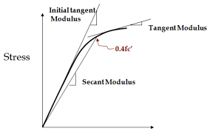
Inelastic Material
The linear behavior of materials only lasts up to a certain strength – the yield strength.
Materials can continue to deform but they won’t restore their shape.
For very high strain a material will break.

Slide 7
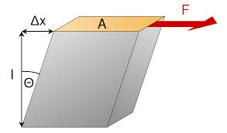
Shear Force
Displacement of a solid can follow the surface of a solid.
This is due a shear force.
One can measure a shear stress σ_{s} and a shear strain ε_{s}.

Slide 8

Shear Modulus
Materials also have a modulus from shear forces.
Shear modulus S also relates to Hooke’s law.
The angle γ = Δx/L is sometimes used for shear.
Sine approximates angle

Slide 9
Volume Stress
P
Pressure from all sides can change the volume of a solid.
There is a volume stress and volume strain.
ΔV
V
A (surface area)

Slide 10
Bulk Modulus
Pressure changes volume, not length.
Bulk modulus B relates changes in pressure and volume.
The negative sign represents the decrease in volume with increasing pressure.
P
ΔV
V
A (surface area)

Slide 11

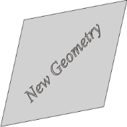
What can happen to a unit volume inside a body on the application of external loads/forces/constraints?
Contraction/dilation
Volume change
What can happen to a unit volume in a material when we apply forces/constraints to the outside of the body
Shape change
Or a combination of these
Shear
Rigid body translation/rotation
Position/Orientation change
As such no distortion to the volume element (but affects neighbouring elements)

Slide 12
Twist a Leg
One common fracture is a torsion fracture. A torque is applied to a bone causing a break.
The shear modulus of bone is 3.5 GPa.
The lower leg has a breaking angle of 3°.
It requires 100 Nm of torque.
Torque and angle apply.
Angle is Δx/L = tanγ
Approximately Rφ/L = γ
Sheer is related to torque.
Rφ
L
γ

Slide 13
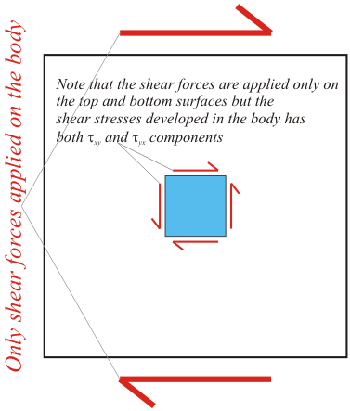
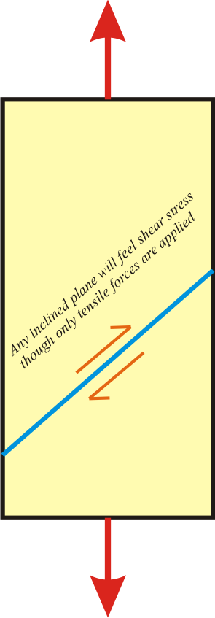
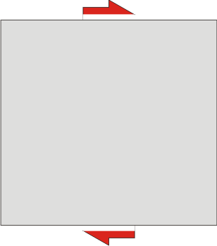
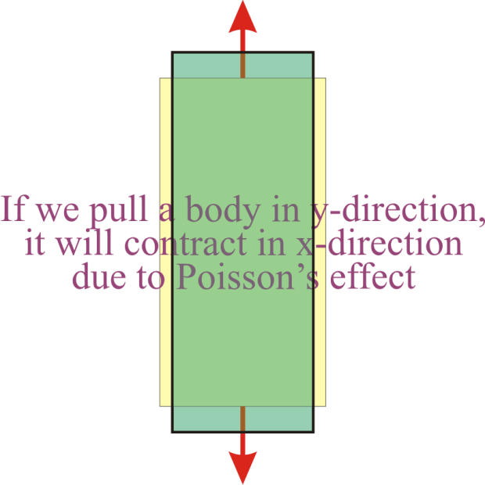
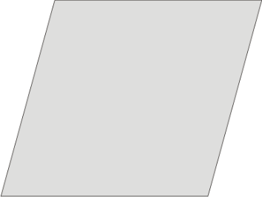
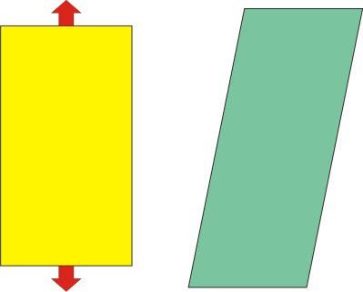
Note:
We can apply forces and not stresses- stresses are developed within the body
Shear
Only shear tends to change the shape of a body without changing its volume
In anisotropic crystals it may do more (may even shear the crystal)!
Anisotropic crystals
Note: we apply shear force and shear stresses develop in the interior of the material

Slide 14

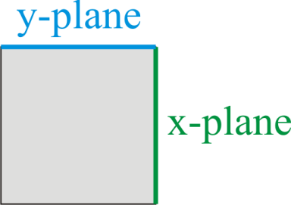

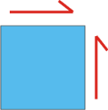
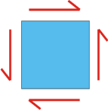
Stress Components
It is easier to understand stress in terms of its components and the effect of the components in causing deformations to a unit body within the material.
These components can be treated as vectors.
Components of a stress: 2D → 4 components [2 σ (tensile) and 2 τ (shear)] 3D → 9 components [3 σ (tensile) and 6 τ (shear)]
σ written with subscripts not equal implies τ (shear stress) e.g. σ_{xy} ≡ τ_{xy}.
First index refers to the plane and the second to the direction.
Close to 2D state of stress (plane stress) can occur in thin bodies and 2D state of strain (plane strain) very thick bodies.
Shear stresses are responsible for plastic deformation in metallic materials.
x-plane, x-direction
Also sometimes written as σ_{x}
Direction
x-plane, y-direction
Plane
As stress is a symmetric tensor in ‘normal’ materials
⇒
⇒

Slide 15
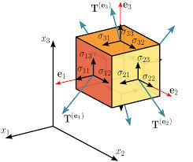
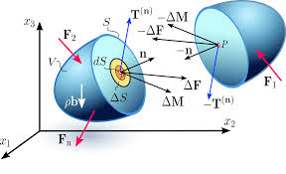
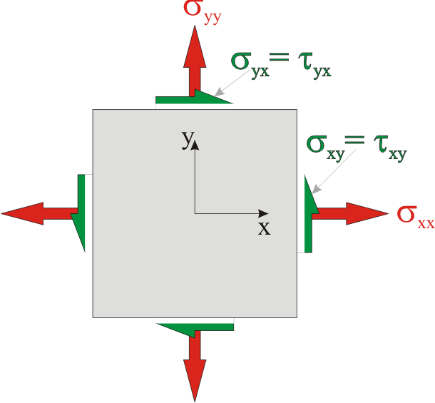
Let us consider a body in the presence of external agents (constraints and forces) bringing about stresses in the body. A unit region in the body (assumed having constant stresses) is analyzed. (body forces are ignored)
Note: the directions of the stresses shown are arbitrary (the stresses in general could be compression/tension and shear could be opposite in sign)
2D
* Note: σ_{xx} = σ_{x}

Slide 16
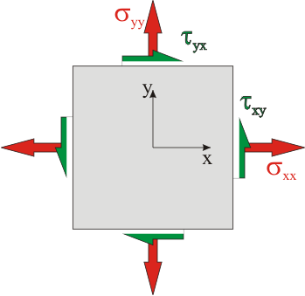
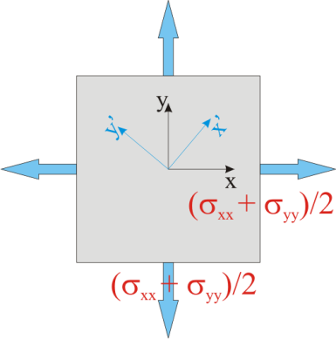
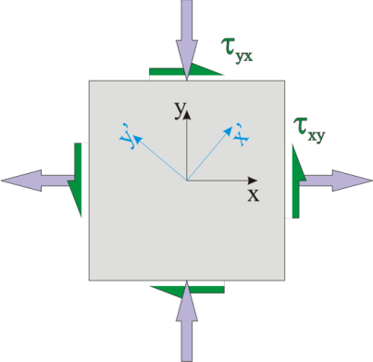
Hydrostatic and Deviatoric Components of Stress
(In metallic materials) Hydrostatic components of stress can cause elastic volume changes and not plastic deformation.
Yield stress (of metals) is not dependent on the hydrostatic stress. However, fracture stress (σ_{f}) is strongly affected by hydrostatic stress.
We understand the concept of hydrostatic and deviatoric stress in 2D first.
Hydrostatic stress is the average of the two normal stresses.
=
+

Slide 17
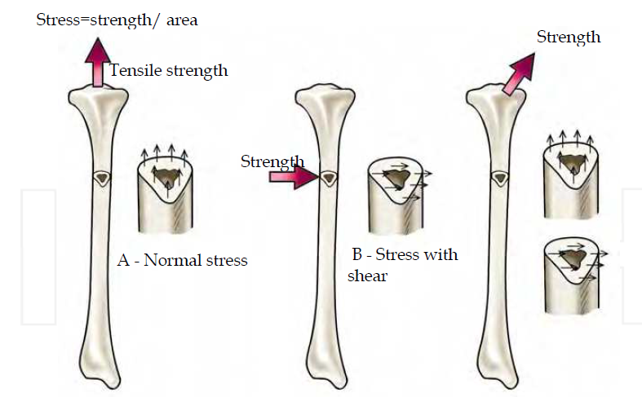
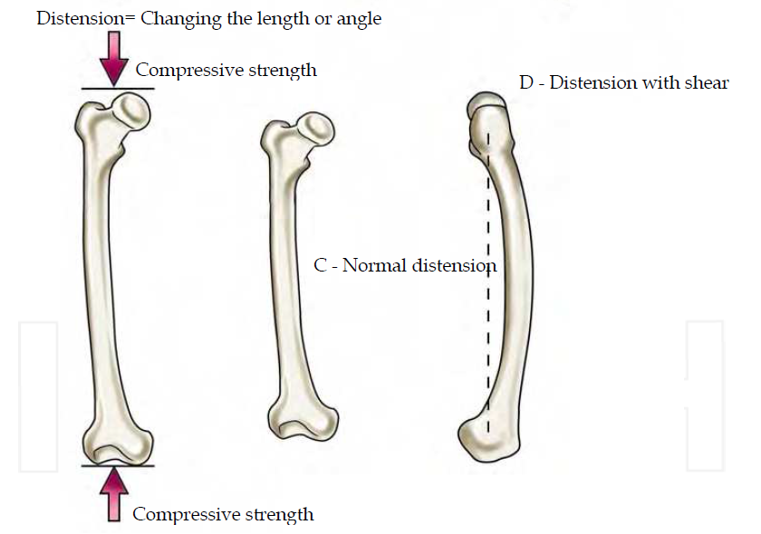
Examples of loading and deformation of Bone Structure
The stress, that is the force by area unit, may occur perpendicularly to the plan (normal stress) as represented in (A), or in parallel to the plan (stress with shear) represented in (B).
The distension or deformation of the material is represented in (C) normal distension, in which the extent varies and (D) distension with shear, in which the angle is changed.

Slide 18
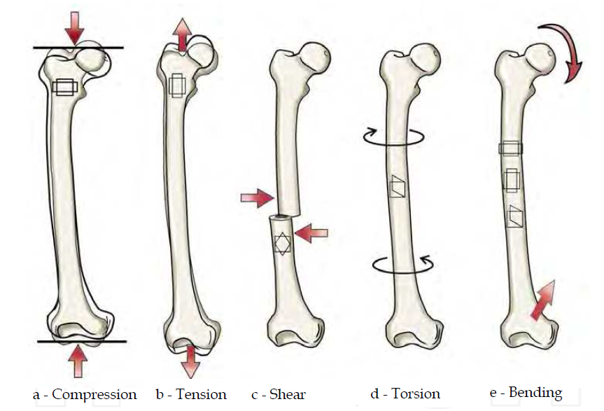
Examples of loading and deformation of Bone Structure
(A) A compressive strength causes shortening and extension, (B) a tensile strength causes narrowing and elongation (C) shear strength and (D) torsional strength creates an angular distortion, and (E) the bending strength includes all changes seen in compression, tension and shear.

Slide 19
~ Thank you for listening ~

